Slide 1
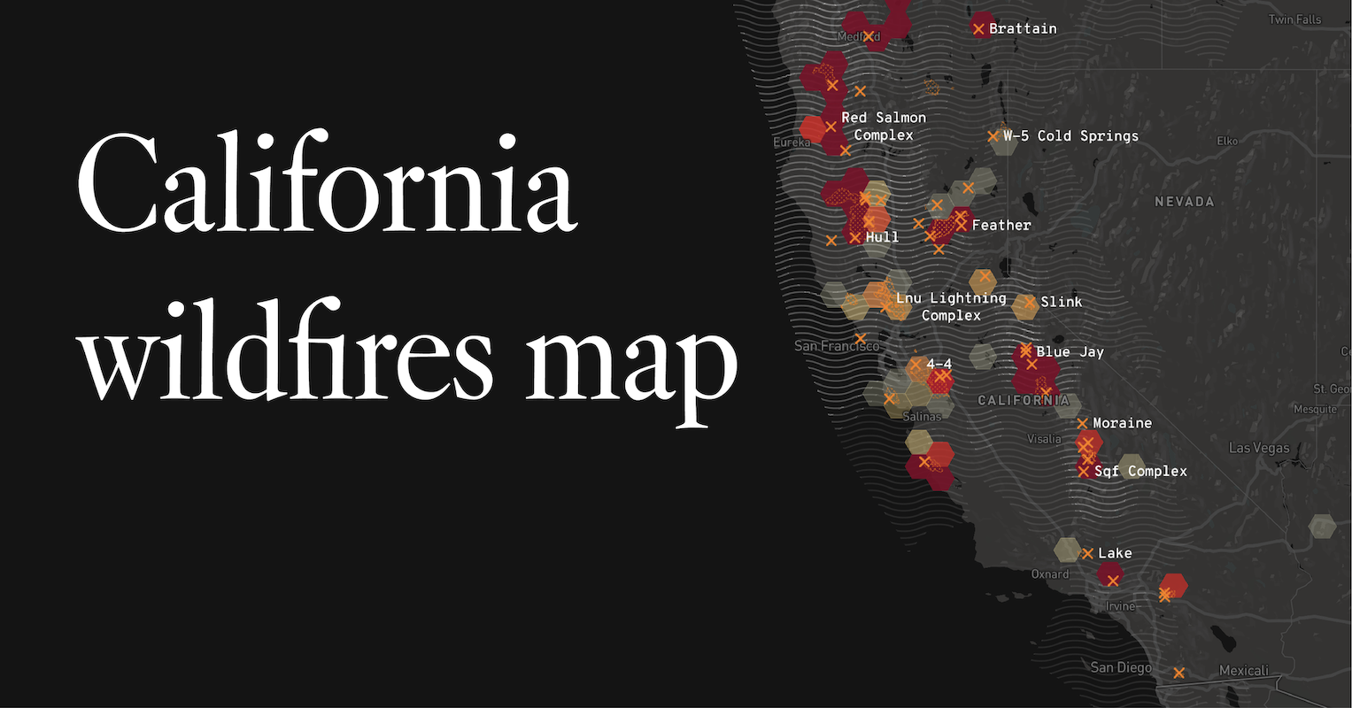
Wildfire Impact on Homeowner Insurance
A Study in California
STAT 523 Project Group 4
Shireen Bano Anees Ahmed, Yiran Guo

Slide 2
Background and motivation
Context: Increasing frequency and severity of wildfires in California.
Impact on Insurance Market:
Rising homeowner insurance premiums.
Challenges with insurance availability in high-risk areas.
Study Goal: Understand the relationship between wildfire risk/losses and homeowner insurance premiums at a granular geographic level (ZIP Code).

Slide 3
Data Overview
Source: Data from California Department of Insurance Residential Property Insurance Report
Scope: Aggregate data by ZIP Code for Homeowner (HO) policies in 2020 and 2021.
Key Variables Used:
ZIP Code
Earned Premium (Total Premium for the year)
Earned Exposure (Measure of insurance coverage duration)
Total CAT Losses (Sum of Catastrophe Fire/Smoke losses for Cov A & C)
Data Characteristics & Potential Challenges:
Aggregate data by ZIP Code (Geographic Granularity).
Limited to 2 years (2020, 2021).
Presence of outliers (very high losses/premiums for some ZIPs).
Data distributions may not be normal (impacts assumption for Pearson correlation).
Potential biases (e.g., premium affected by other major factors, differences in policy types within same type of insurance)

Slide 4
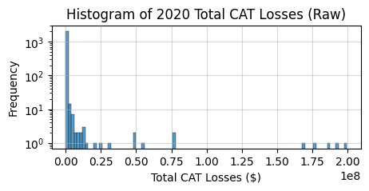

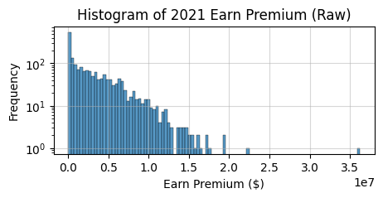
Analysis Phase 1: Normality
To find the potential linear relationship between raw 2020 Total CAT Losses and raw 2021 Earned Premium by ZIP Code, we first need to confirm normality.
We performed Shapiro-Wilk test, where the test statistics
Null hypothesis: data are normally distributed
P-values for both 2020 losses and 2021 Premiums are ~0
Neither sample sets are normally distributed
Next, we need to find the relationship between this two with a correlation test. With the lack of normality, we decided to use Spearman’s Rank Correlation Test

Slide 5

Analysis Phase 1: Spearman Correlation
Spearman’s Rank Correlation
Measures monotonic relationship between 2 ranked variables
ZIP-Code-wise premium and CAT losses
Used when data is ordinal or non-normal
ρ=1: Perfect increasing monotonic relationship
ρ=-1: Perfect decreasing monotonic relationship
Null Hypothesis (H₀): There is no monotonic relationship between Total CAT losses and Earned Premium (ρₛ = 0)
Alternative Hypothesis (H₁): There is a monotonic relationship between Total CAT losses and Earned Premium (ρₛ ≠ 0)
Result: ρₛ: 0.4809, P-value: ~0, reject null hypothesis
Conclusion: There is a statistically significant monotonic relationship between the variables.

Slide 6
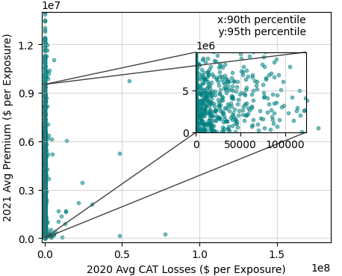
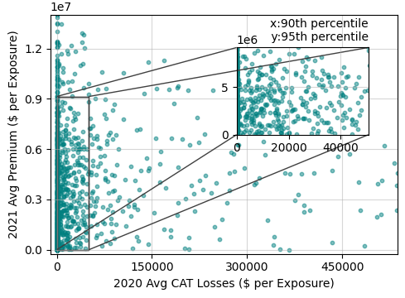
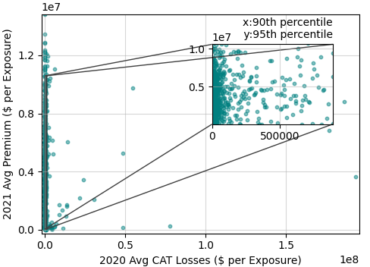
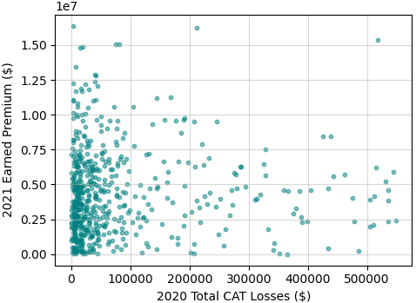
Analysis Phase 1: Spearman Correlation
Raw
Trim top
However some of the ZIP codes may be expectedly heavily impacted by wildfire, resulting in high CAT losses (outliers)
Other ZIP Codes may have no CAT losses claim, resulting in 0 CAT losses but non-zero collected premium
We considered four cases to trim the data:
Raw, data as received (ρₛ=0.4809, p=0)
Trim out data beyond 99th percentile outliers (top) (ρₛ=0.4765, p=0)
Trim out zero-losses data point (bottom) (ρₛ=0.0565, p=0.1459, no relationship)
Trim out both top and bottom (ρₛ=0.0899, p=0.0338, likely relationship)
Trim bottom
Trim both

Slide 7
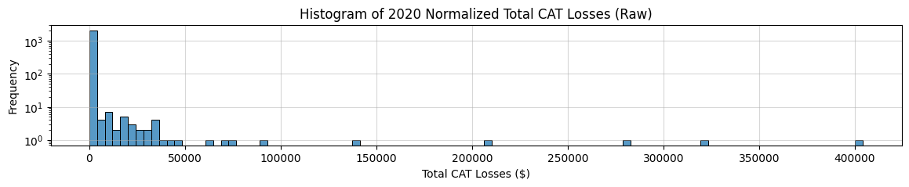
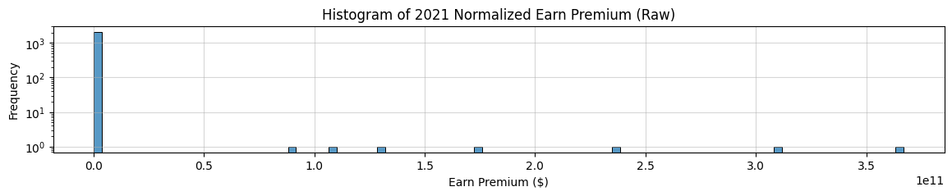
Analysis Phase 2: Normalized Data
Observation: ZIP Codes are of different size (# of insured dwellings) and premium also depends on ZIP-Code-related factors such as property/land values. We consider further looking into the data by normalizing both premium and CAT losses with number of exposures (dwellings insured)
Goal: Quantify the linear relationship between normalized 2020 Avg CAT Losses (per exposure) and normalized 2021 Avg Premium (per exposure) by ZIP Code.
We can easily identify some outliers from the histograms
Shapiro-Wilk test further confirms normalized data sets are still likely non-normal (p-value for both 0)

Slide 8
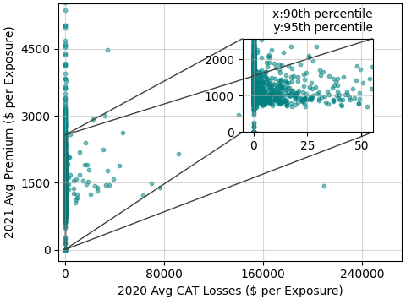
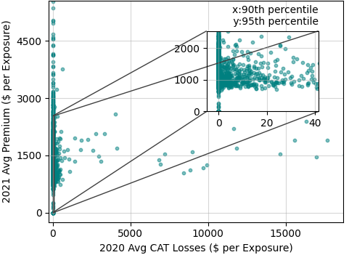
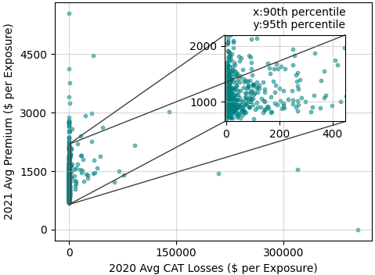
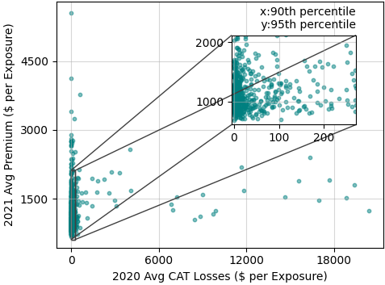
Analysis Phase 2: Normalized Data
Raw, normalized
Trim top, normalized
We also considered four cases to trim the data:
Raw normalized, data as received (ρₛ=0.0086, p=0.6925, no relationship)
Normalized, Trim out data beyond 99th percentile outliers (top) (ρₛ=-0.0104, p=0.6328, no relationship)
Normalized, Trim out zero-losses data point (bottom) (ρₛ=0.2105, p=0, there is relationship)
Normalized, Trim out both top and bottom (ρₛ=0.1609, p=0, there is relationship)
Trim bottom, normalized
Trim both, normalized

Slide 9
Analysis Phase 2: Normalized Data
Raw, normalized
Trim top, normalized
Overall, both trimming zero-losses ZIP Codes (ρₛ=0.2105, p=0) and trimming both zero-losses and 99th percentile (ρₛ=0.1609, p=0) methods results in strong evidence for monotonic relationship between average (normalized) CAT losses and average premium in the following year
We proceeded with an informed strategy to perform linear regression with data trimmed of both top and bottom
Trim bottom, normalized
Trim both, normalized

Slide 10
Analysis Phase 3: Linear Regression
We used scikit-learn to perform Linear Regression analysis on the normalized, trimmed of top and bottom data (x = Average CAT losses 2020, y = Average Earned Premium 2021)
Trimming resulting a reduction of data points from 2118 to 645
Results:
Intercept: -381.92
Mean Squared Error on the test set: 1488.80
We evaluated the model with on known features (normalized when applicable) from 2021:
Trained Model Coefficients
Avg_Premium: 1.1097
Avg_CAT_Loss: 0.0006
Avg_Claims: 74.7985
Avg_Fire_Risk: 682.9125
ZIP Code: 0.0040

Slide 11
Conclusions
MSE on Test Set: 1488.80 On average, your model's predictions are off by the square root of this value, i.e., about $38.6 (since RMSE = √MSE = √1488.8 ≈ 38.6).
Avg Premium 2020 (1.1097) ➤ For each 1-unit increase in the average premium in 2020, the predicted average premium in 2021 increases by about $1.11. Makes sense — past premium is a strong predictor of future premium.
Avg CAT Loss (0.0006) ➤ For each additional $1 in CAT losses per exposure, the premium increases by 0.06 cents. Impact is small, but positive — expected, since CAT losses signal risk.
Avg Claims (74.7985) ➤ For each additional claim per exposure, the premium increases by about $74.80. That's substantial — more claims → more risk → higher premiums.
Avg Fire Risk (682.9125) ➤ For each 1-unit increase in fire risk score per exposure, premium increases by $682.91. Huge influence — likely a strong underwriting factor. Fire risk score in [0,4]

Slide 12
Bibliography
California State Department of Insurance Residential Property Insurance Report
https://www.insurance.ca.gov/0400-news/0200-studies-reports/0250-homeowners-study/
Wikipedia, California FAIR Plan
https://en.wikipedia.org/wiki/California_FAIR_Plan
Wikipedia, Spearman’s Rank Correlation
https://en.wikipedia.org/wiki/Spearman%27s_rank_correlation_coefficient
Wikipedia, Shapiro-Wilk test
https://en.wikipedia.org/wiki/Shapiro%E2%80%93Wilk_test
Google Gemini AI, for plotting assistance and clean up
https://gemini.google.com/app
Python packages used: python, pandas, numpy, scipy.stats, scikit-learn, matplotlib, seaborn

